Slide 1
Day 4
Session 1

Slide 2
Objectives
Exceptions Handling -
User Defined Exception
String Functions
String Buffer

Slide 3
Exception Handling
Throw →The Java throw keyword is used to throw an exception explicitly.
We specify the exception object which is to be thrown.
throw new exception_class("error message");
Let's see the example of throw IOException.
throw new ArithmeticException(“Invalid number");
Use to create userdefine Exception.
D5

Slide 4
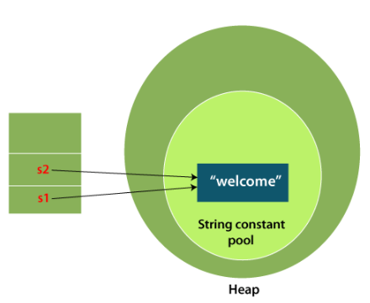
Strings
Strings in Java are Objects that are backed internally by a char array.
An array of characters works same as Java string.
Whenever a change to a String is made, an entirely new String is created.

Slide 5
Strings
Memory allotment of String
Whenever a String Object is created as a literal, the object will be created in String constant pool. This allows JVM to optimize the initialization of String literal.
For example:
String str = “Bhushan";
The string can also be declared using new operator i.e. dynamically allocated. In case of String are dynamically allocated they are assigned a new memory location in heap. This string will not be added to String constant pool.
For example:
String str = new String(“Bhushan");
If you want to store this string in the constant pool then you will need to “intern” it.
For example:
String internedString = str.intern(); // this will add the string to string constant pool.
D6

Slide 6
Strings
String Operation →
charAt()
equalsIgnoreCase()
concat()
contains()
endsWith()
equals()
length()
trim()
toUpperCase()
toLowerCase()
startsWith()
substring()
D7

Slide 7
String Buffer
Java StringBuffer Class
Java StringBuffer class is used to create mutable (modifiable) String objects. The StringBuffer class in Java is the same as String class except it is mutable i.e. it can be changed.
D9

